Slide 1
The Minnesota Health Plan
Moving Beyond Obamacare

Slide 2
National organization with 18,000 members
Access to quality health care is a right of all people
MN chapter supports the Minnesota Health Plan as the most efficient and equitable means of achieving high-quality care for all Minnesotans

Slide 3
Our current dysfunction
The Affordable Care Act
A better way forward: The Minnesota Health Plan

Slide 4
Our current “system”
48 million uninsured
Private insurance
(individually purchased)
Private insurance
(job-based)
Medicaid
Medicare
VA
Indian Health Service

Slide 5
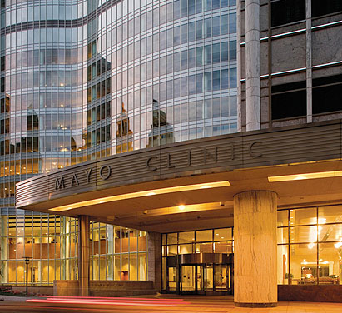
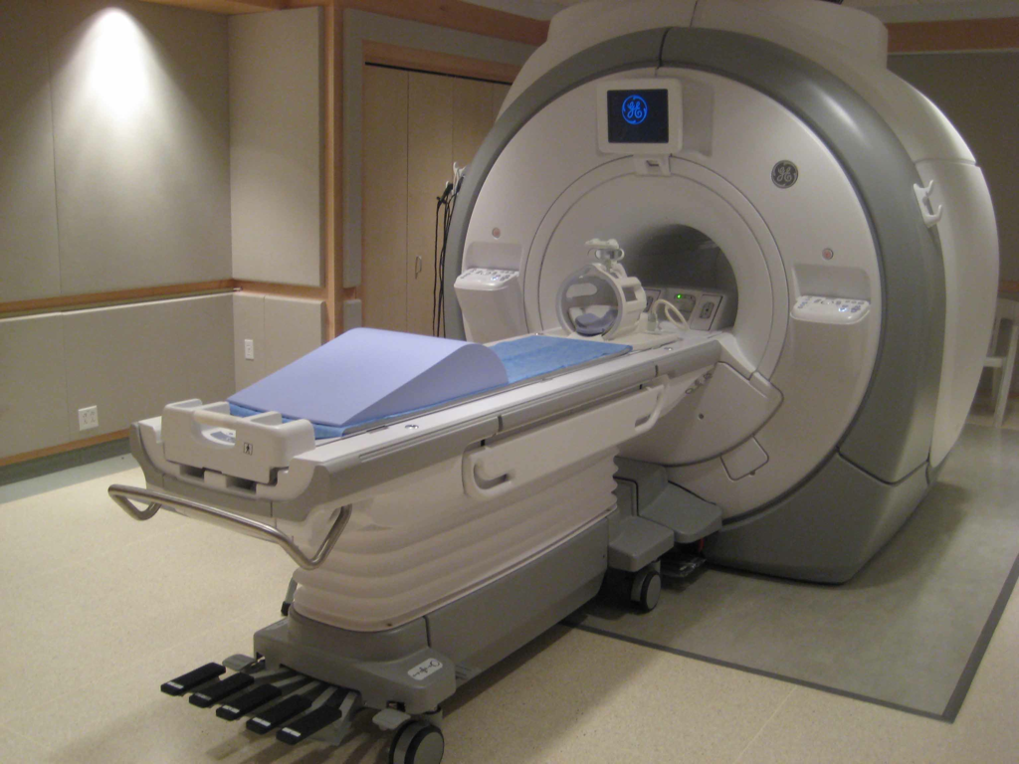
How good are we?
“Best In The World!”

Slide 6
On the other hand…
Cost: most expensive in the world
Access: uneven, tens of millions left out
Quality: mediocre outcomes

Slide 7
Cost

Slide 8
Cost
18% of GDP
Twice as much as other democracies
Unaffordable for many
Average family premium now $15,700
Doubled in 10 yrs, while wages stayed flat
62%of personal bankruptcies due to health bills

Slide 9
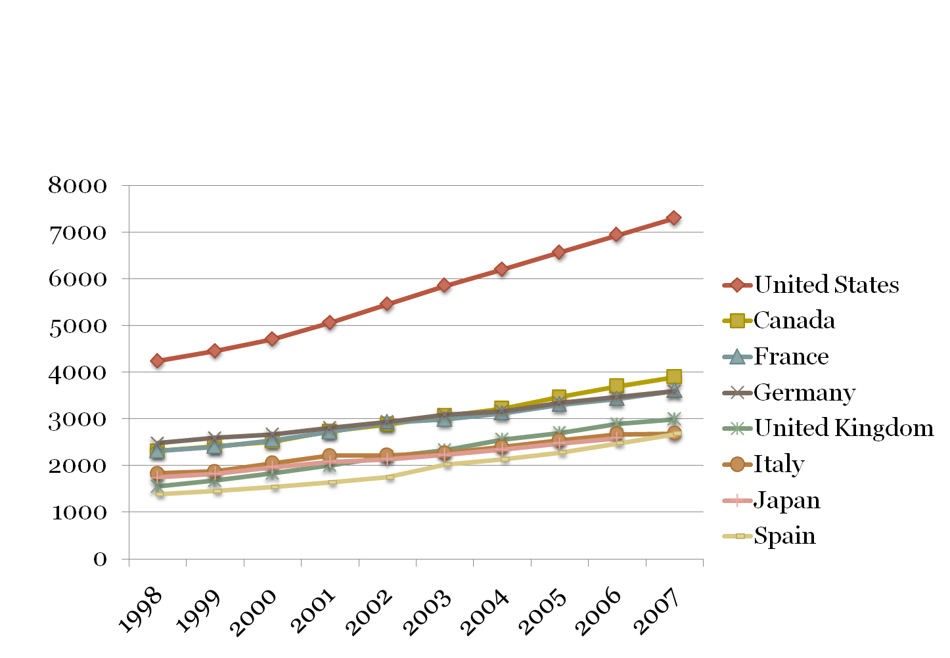
Per Capita Spending (In U.S. Dollars)
Notes:
Now around $8600 per capita

Slide 10
Average Annual Premiums for Single and Family Coverage, 1999-2012
$5,615*
$15,745*
* Estimate is statistically different from estimate for the previous year shown (p<.05).
Source: Kaiser/HRET Survey of Employer-Sponsored Health Benefits, 1999-2012.

Slide 11
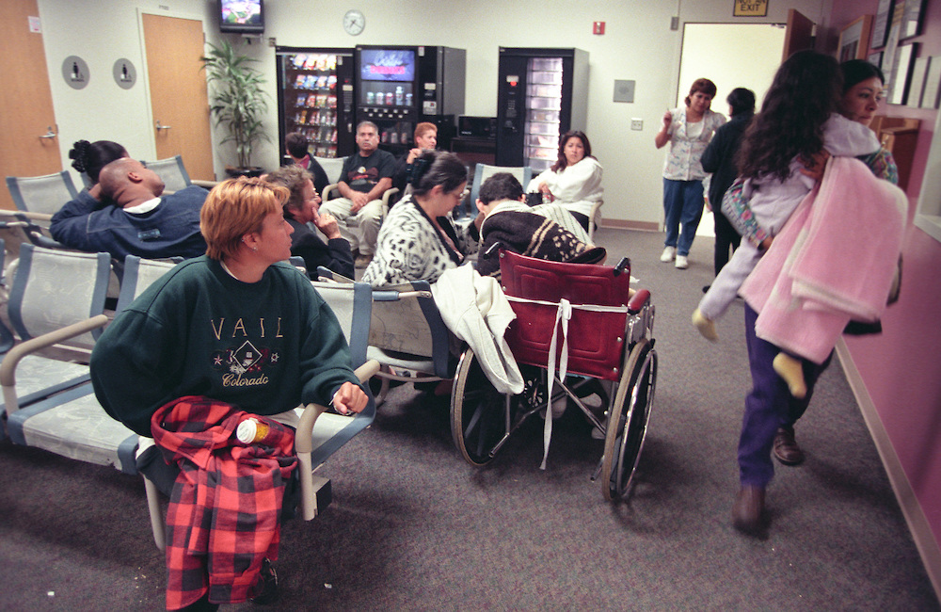
Access

Slide 12
Access
The uninsured
The underinsured

Slide 13
The uninsured
48 million
7 million in 2010 due to job loss
446,000 Minnesotans
63% are working full time
Current Population Survey Annual Social and Economic Supplement (CPS), 2012

Slide 15
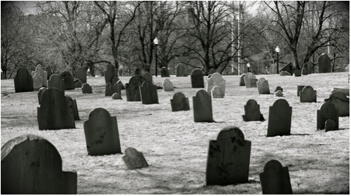
Does being uninsured matter?
45,000 deaths per year due to lack of insurance
40% higher risk of death
The uninsured live sicker, die sooner
Wilper, et al., Am J Public Health,2009, 99:12

Slide 16
Underinsurance
Insured, but inadequately
Unaffordable out-of-pocket costs
High deductibles and copays
29 million, and growing
80% increase from 2003-2010
Avoidance of necessary care
Illness can bring financial ruin

Slide 17
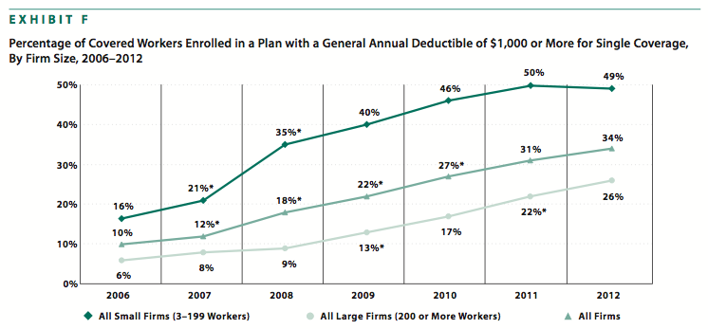
High-deductible plans
Kaiser/HRET Survey of Employer-sponsored health benefits, 2006-2012

Slide 18
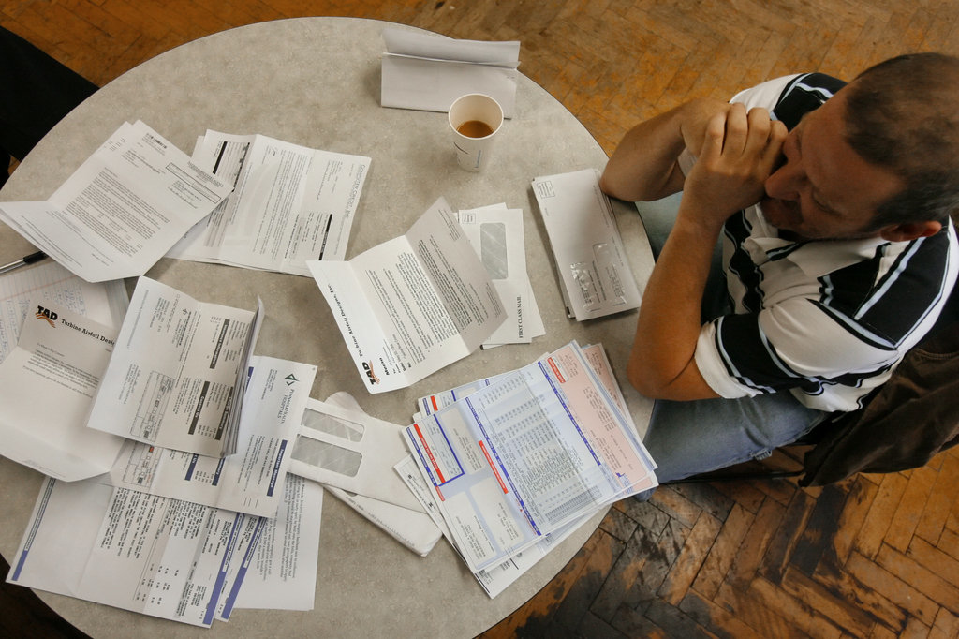
Consequences
75 million skipped needed care in 2010 due to cost
25% with chronic conditions skipped prescriptions due to cost
29 million used all their savings to pay bills
-Kaiser Family Foundation, 2011

Slide 19
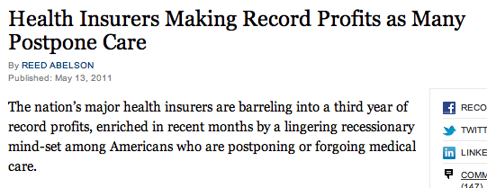

Slide 20
Quality

Slide 21
Quality
US Health Outcomes
Life expectancy: 28th/193
Infant mortality: 41st
Overall: 37th
Worse outcomes than almost any other advanced democracy
World Health Organization, 2011

Slide 22
“Amenable mortality”
Unnecessary, premature deaths
Preventable with timely health care
US has highest rate out of 16 high-income countries
Commonwealth Fund, 2011

Slide 23
What’s going on here?
How can we spend so much….
…and get such poor outcomes?

Slide 24
Inefficiency!
31% of US health spending goes to administrative costs
(Woolhandler, NEJM, 2003)
Two components:
Providers
Payers

Slide 25
Providers
Must contend with complexities of hundreds of insurance plans
Differing coverage for each patient
Paperwork, pre-authorization requirements
21 hours/week per practice (Canada 2.5 hrs)
-Moira, Health Affairs, 2011
Hospitals must operate large billing departments

Slide 26
Hospital billing/administration
Dollars per capita, 2011
Woolhandler/Himmelstein/Campbell. NEJM 2003;349:769 (updated 2012)

Slide 27
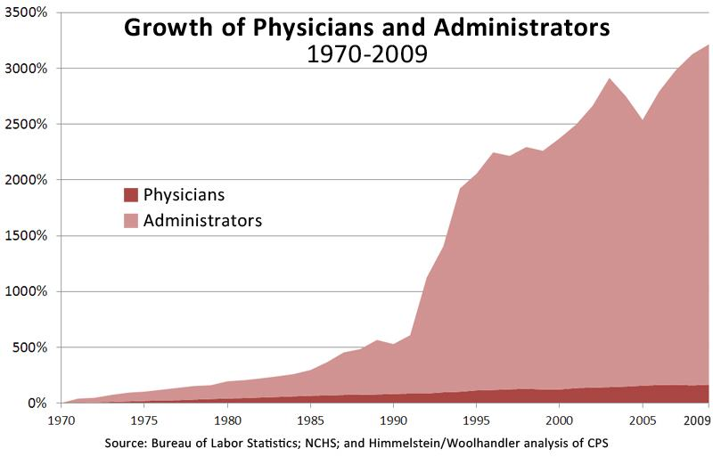

Slide 28
Private insurance
1,500 companies that do the same thing
Duplicative functions
Advertising
Marketing/sales
Underwriting
Enrolling/disenrolling
Negotiating multiple provider contracts
Lobbying
Executive salaries
Top 10 CEO’s: $229 million (2009)
Shareholder profits
Top 5 insurers: $12.2 billion in 2009
2.7 million Americans lost coverage that year

Slide 29
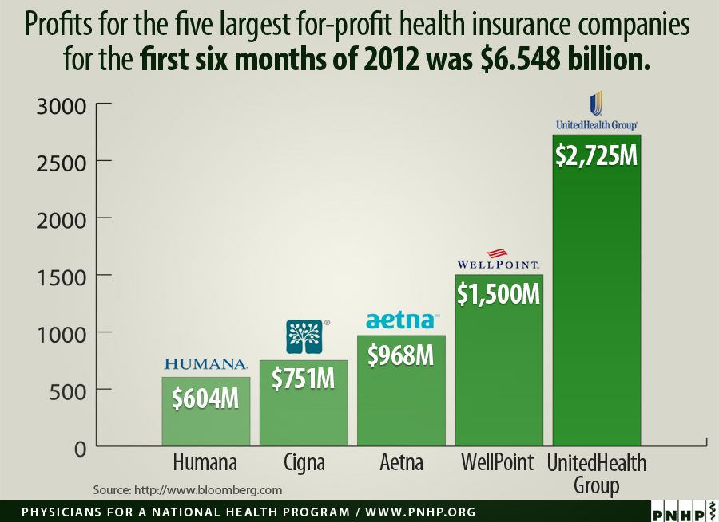

Slide 30
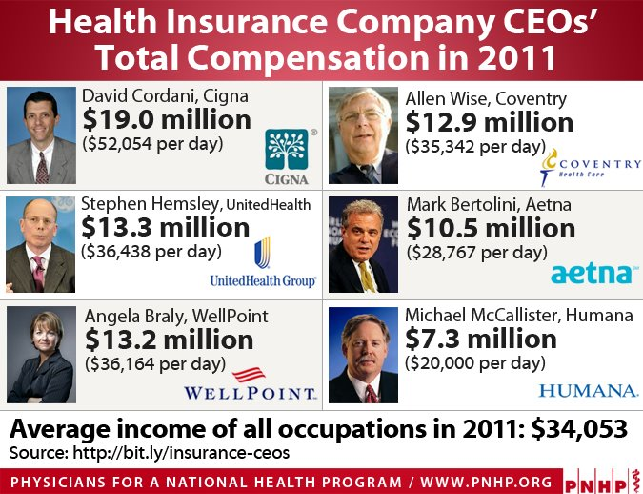

Slide 31
Insurance overhead
Medicare
Non-profit Blues
Commercial carriers
Investor-owned Blues
- International Journal of Health Services 2005

Slide 32
Shouldn’t we be spending these health care dollars on HEALTH?

Slide 33
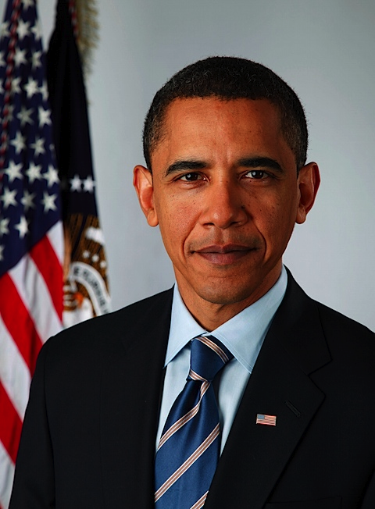
Affordable Care Act
Pro’s
Millions more insured
Private insurance reform
No denial for pre-existing conditions
No annual or lifetime caps on coverage
Cons
30 million left uninsured
Builds on inefficient, profit-driven system
Maintains central role of private insurance
Underinsurance remains
Continued cost explosion

Slide 34
-Health Affairs: June 6, 2013
30 million to remain uninsured after ACA fully implemented
Minnesota: 250,000
Notes:
researchers from Harvard and University of NY School of Public Health

Slide 35
ACA: underinsurance

Slide 36
“While the legislation will enhance access to insurance, the trade-off will be an accelerated crisis of costs and perpetuation of the current dysfunction.”
- Jeffrey Flier
Dean of Harvard Medical School
Notes:
researchers from Harvard and University of NY School of Public Health

Slide 37
What is the Minnesota Health Plan?
An innovative change in the way we pay for health care in Minnesota
A single, streamlined public fund
Eliminates private insurance and profit-taking
Slashes inefficiencies
Negotiating clout for drugs and medical supplies
Guarantees quality coverage for all Minnesotans
Medical and dental
De-linked from employment

Slide 38
446,000 uninsured Minnesotans
Private insurance
(individually purchased)
Private insurance
(job-based)
Medicaid
Medicare
VA
Indian Health Service

Slide 39
Minnesota Health Pan
Simple, streamlined fund
Publicly financed
Publicly accountable
Non-profit
Health care delivery remains private and high-quality

Slide 40
Minnesota Health Plan

Slide 41
Could it work?
Lewin Group Report (2012)
Economic model of single, unified plan in MN
ALL Minnesotans covered
Including 250,000 left uninsured by ACA
Medical, prescription meds, mental health, dental
Financing
Employer and employee payroll tax
Eliminates deductibles, co-insurance, most copays

Slide 42
Lewin Group Findings
All Minnesotans with full coverage
$4 billion saved in 2014
9% savings
10-year savings (2014-2023): $65 billion
Businesses currently providing insurance save $1,214 per employee/year
Average family saves $1,362/year

Slide 43
Minnesota Health Plan advantages
Guaranteed high-quality coverage for all Minnesotans
True health care security
Continuous, de-linked from employment
Freedom to choose your provider
Efficient coverage
Simplified and streamlined
Eliminates administrative waste
Saves billions for Minnesota families and businesses

Slide 44
Will you help us make it happen?
Volunteer with PNHP
Talk with neighbors, friends, family
Invite us to speak to your people
Church
Business
Neighborhood group
Social organization
Contact your state legislator
Sign up with us today!
PNHPminnesota.org

