Slide 1
The Relationship Between Single-Payer Healthcare and Cancer Disparities: Can Minnesota Do Better?
Ann Settgast, MD
Cancer Disparities Summit
Minnetonka, Minnesota
June 19, 2013

Slide 2
Objectives
Define the problems of uninsurance and underinsurance
Compare healthcare cost & quality of the USA to other industrialized nations
Explore evidence linking cancer disparities to uninsurance and undersinsurance status
Explain how a single-payer solution differs from the Affordable Care Act and provide update on where we are in Minnesota

Slide 3
Disclosures
No financial relationships
No discussion of off-label or investigational use

Slide 4
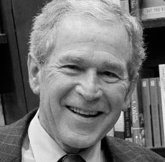
“The U.S. health care system becomes a
more embarrassing disaster
each year.”
Donald Kennedy, Former editor Science
August 15, 2003
“America has the
best health care system
in the world, pure and simple.”
President George W. Bush, addressing
the American Hospital Association,
May 1, 2006

Slide 5
National research & education
organization of 18,000 members
advocating universal, comprehensive,
single-payer health insurance
Single-payer provides a
more cost efficient and equitable way
to administer high-quality health care to all

Slide 6
Socialized Medicine
Publicly financed
Publicly owned
Single-Payer System
Publicly financed
Privately owned (delivered)

Slide 7
Where Are We Now?
Access
US has
major
problems
in all three areas
Cost
Quality

Slide 8
Number of Uninsured Americans 1976-2011
50
45
40
35
30
25
20
Millions of Uninsured American
1976 | 1980 | 1985 | 1990 | 1995 | 2000 | 2005 | 2011
Source: Himmelstein, Woolhandler & Carrasquilo.
Tabulation from CPS & NHIS data

Slide 10
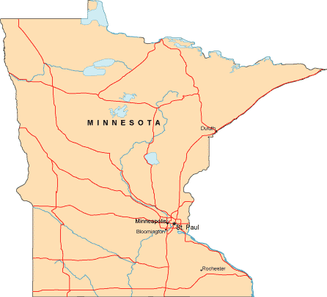
446,000 Uninsured
63% have a full-time worker in the household.
Source: Current Population Survey Annual Social and Economic Supplement (CPS), 2012
Notes:
Source: SHADAC website – this is 2011 data. CPS data likely underrepresents uninsurance rate as it requires recall over 15 months (ie. respondant is asked in March 2012 to recall data from Jan-Dec 2011). Often, respondants report current coverage rather than what happened before, and so we don’t capture all of the uninsurance.

Slide 11
Chronically Ill Are Uninsured
16.6%
11.9%
15.5%
19.3%
15.4%
Percent with disease
and no insurance
16.1%
Millions of uninsured with disease
Source: Wilper et al. Annals Internal Medicine 2008;149:170.

Slide 12
Does Being Uninsured Matter?
45,000
Adult Deaths
Every Year
Model adjusted for gender, age, race/ethnicity, income level, education, employment status, smoking status, alcohol use, exercise habits, self-reported health status…
Wilper et al. American Journal of Public Health, 2009
Notes:
IOM estimated this # at 18,000 in 2001. Current study analyzed data from NHANES III (1988-1994 with f/u through 2000)
12

Slide 14
Uninsured and Under-Insured Delay Seeking Care for Heart Attacks
Odds ratio for delayed care*
Source: JAMA April 15, 2010. 303:1392
*Adjusted for age, sex, race, clin. charact., hlth status, social/psych fx, urban/rural.
Under-insured=had coverage but patient concerned about cost

Slide 15
Under-Insurance Drives Bankruptcies
Over 75% of the medically bankrupt had insurance at the onset of their illness
62% of bankruptcies are due to medical expenses
Source: Himmelstein et al. Am J Med. Aug. 2009

Slide 16
Under-Insurance Drives Bankruptcies
“Medical impoverishment,
although common in poor nations,
is almost unheard of
in wealthy countries
other than the US.”
Source: Himmelstein et al. Am J Med. Aug. 2009

Slide 17
Patients with High Deductibles Forego Needed Care
Percentage delaying or avoiding care due to cost
Commonwealth Fund / EBRI Survey 3/08
Notes:
Even 1 day in the hospital would push a patient past the deductible threshold, eliminating any cost-saving incentives for the small group of sick patients who account for the vast majority of health costs.
In 2010, the number of either uninsured or “underinsured” (i.e., people with health coverage that does not adequately protect them from high medical expenses) increased to more than 80 million. (Commonwealth Fund report May 2012)
243,000 Minnesotans had HSAs in 2006 vs 720,000 in 2011 (Strib 2/2/11)

Slide 19
Where Are We Now?
Access
US has
major
problems
in all three areas
Cost
Quality

Slide 20
Average spending on health per capita ($US PPP)
Note: PPP = Purchasing power parity—an estimate of the exchange rate required to equalize the purchasing power of different currencies, given the prices of goods and services in the countries concerned.
Source: OECD Health Data 2011 (Nov. 2011).
Notes:
Rising costs cannot be halted w/ the status quo. It has been said that if America had the per-person cost of any of these countries, our deficit would vanish.

Slide 21
Percent of population over age 64
Data are for 2011 or most recent year available. Source: OECD, 2012

Slide 22
Note: Data are for 2010 or most recent year available. Source: OECD, 2012

Slide 23
Hip Replacements are for 2010 or most recent year available, OECD 2012
Bone Marrow Transplants are for 2008 or more recent year available, OECD 2010
Notes:
In 2009, the U.S., along with Germany, performed the most knee replacements (213 per 100,000 population) among the study countries, and 75 percent
more knee replacements than the OECD median. (Commonwealth Fund May 2012 report, “Issues in International Health Policy”)
Utilization of imaging was highest in the U.S., with 91.2 MRI exams and 227.9 CT exams per 1,000 population. (Commonwealth Fund May 2012 report)
What about our medical malpractice costs? Aren’t these the reason our costs are so high?? “No - its direct costs — premiums, payouts, legal fees, etc. — amount to about one-half of 1 percent of total U.S. health-care spending. It’s barely a rounding error.” – Washington Post, March 5, 2012 – Ezra Klein
Also, same article: In October 2009, in response to a request from Sen. Orrin Hatch (R-Utah), the Congressional Budget Office took a careful look at the evidence on defensive medicine and concluded that aggressive reforms to the medical malpractice system “would reduce total national health care spending by about 0.5 percent.”

Slide 24
Where Are We Now?
Access
US has
major
problems
in all three areas
Cost
Quality

Slide 25
Life Expectancy
Years
Note: Data are for 2010 or most recent year available. Source: OECD, 2012

Slide 26
Infant Mortality Deaths in First Year of Life Per 1,000 Live Births
Note: Data are for 2010 or most recent year available. Source: OECD, 2012

Slide 27
Maternal Mortality Deaths per 100,000 Live Births
Note: Data are for 2009 or most recent year available. Source: OECD, 2011

Slide 28
Amenable Mortality
France
Australia
Italy
Japan
Sweden
Norway
Austria
Netherlands
Finland
Germany
Greece
Ireland
New Zealand
Denmark
UK
US
0 | 200 | 400 | 600 | 800 | 1000 | 1200
Age adjusted deaths/100,000 from potentially preventable causes
Source: Health Affairs 2008;27(1):58 and on-line 9/12/11
Notes:
Study analyzed mortality (under age 75 and excluding infants) in 19 industrialized countries from causes potentially amenable to timely & effective healthcare. Amenable conditions are those from which it is reasonable to expect death to be averted after the condition develops. Items include bacterial infections, DM, HTN, common surgical procedures (eg. appendicitis), easily preventable or treatable cancers (cervix, testicular respectively).
If US performed at the level of the top 3 countries, 101,000 deaths would be avoided.
Eight countries moved from ICD-9 to ICD-10 including US.
Underperformance of the US healthcare system.
However, update to this information is the fact that MINNESOTA has the lowest amenable mortality rate in the US of all the states coming in just under France (63.9 per 100,000)

Slide 29
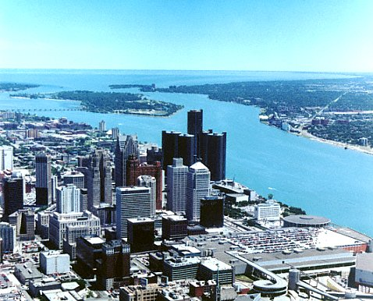
What About the Masses of Canadians Flooding Across the Border for Care???
35 of 35,000 annual admissions to Detroit’s largest hospital network were Canadian
0.5% of Canadians received healthcare in the US, but only 0.11% (or 20 of the 18,000 surveyed) did it intentionally!
Steven J. Katz et al., “Phantoms in the Snow: Canadians’ Use of Healthcare Services in the United States,” Health Affairs, May/June 2002; 21(3): 19-31
Steven J. Katz et al., "Canadians' use of US medical services," Health Affairs 1998;17(1):225-235

Slide 30
Association of insurance status with stage at diagnosis for 12 cancer sites
> 3 million patients included using the US National Cancer Database (NCD)
Uninsured patients have a substantially increased r/o being diagnosed w/ more advanced disease
Finding noted across all cancer types except ovary and pancreas
Conclusion: “Absence of adequate insurance…might be a more feasible factor to address than many other personal and societal factors.”
Halpern et al, Lancet Oncology, Feb 2008
Notes:
…than privately insured

Slide 31
Cervical Cancer
> 76,000 patients from the NCD with first primary invasive tumor of the cervix b/w 2000-2007
Uninsured patients
1.4 times as likely to be diagnosed w/ stage III dz
1.3 times as likely to be diagnosed w/ stage IV dz
Uninsured & underinsured patients had lower f/u rates after an abnormal result
Fedewa et al, Am J of Pub Health, Sept 2012

Slide 32
Breast Cancer
Age-adjusted prevalence of mammography in the past 2 years:
73% for women with health insurance
40% for women without
> 500,000 women > age 40 diagnosed with invasive breast CA & reported to the NCD
Proportion with stage III/IV at diagnosis:
8% among privately insured
18% among uninsured
Halpern et al, Cancer, July 2007

Slide 33
Oropharyngeal Cancer
> 40,000 patients from the NCD with invasive o/p cancer included
Patients with advanced o/p cancer at dx were more likely to be uninsured (OR 1.37)
Patients were most likely to present with the largest tumors (T4 disease) if they were uninsured (OR 2.82)
Chen et al, Cancer, July 2007

Slide 34
5-Year Cancer Survival
Colorectal cancer: 63% for the privately insured but 49% for the uninsured
Breast cancer: 85% for those with private insurance, 75% for the uninsured
Coleman et al, Lancet Oncology, Aug 2008

Slide 36
Survival after craniotomy for brain tumor
>28,000 patients who underwent craniotomy for brain tumor analyzed using the Nationwide Inpatient Sample
In-hospital mortality, 2.6 x more likely for those w/o insurance after adjusting for patient characteristics, co-morbidity, and hospital
Quninones et al, Archives of Surgery, Nov 2012

Slide 37
What Is Single Payer?
Hospitals & clinics now bill
more than 1,000 payers (insurers)
In a single-payer system,
there would be no private health insurance for items covered by the single-payer
Recovery of $400 billion annually due to drastically reduced administrative costs
Woolhandler S. et al. “Costs of Health Care Administration in the United States and Canada,”
New England Journal of Medicine 2003;349:768-75
Notes:
Enough to cover the nation’s uninsured.

Slide 38
Why Do We Pay More But Get Less?
31%
of healthcare dollars is spent on administration
Administrative spending comes from two sides:
Providers
Payers
Woolhandler S. et al. “Costs of Health Care Administration in the United States and Canada,”
New England Journal of Medicine 2003;349:768-75

Slide 39
Hospital Billing and Administration
Dollars per capita, 2011
Woolhandler/Himmelstein/Campbell. NEJM 2003;349:769 (updated 2012)
Notes:
24% of the average hospital budget is devoted to billing.

Slide 40
Interactions Between Physician Practices & Insurers Are Costly
Spending interacting
with payer(s)
Per physician
per year
Morra et al, Health Affairs, August 2011, 30:8, 1443-1450
Notes:
Different formularies
Prior authorizations
Different rules for billing, claims submission, and adjudication
24% of the average hospital budget is devoted to billing.
U.S. physicians’ office staff spent 20.6 hours per physician per week interacting with health plans — nearly ten times that of their Ontario counterparts.

Slide 41
Why Do We Pay More But Get Less?
31%
of healthcare dollars is spent on administration
Administrative spending comes from two sides:
Providers
Payers
Woolhandler S. et al. “Costs of Health Care Administration in the United States and Canada,”
New England Journal of Medicine 2003;349:768-75

Slide 42
Insurance (Payer) Overhead
International Journal of Health Services 2005; 35(1): 64-90
Notes:
42
42
Medicare pays little or nothing for marketing, underwriting (doing research on people’s health histories and adjusting premiums accordingly), lobbying and profit. Keep in mind the other expenses in insurance system: administration, profits

Slide 43
Why Are Private Insurer Admin Costs Higher Than Medicare’s?
Advertising / marketing
Enrolling / disenrolling
Underwriting
Negotiating multiple contracts with providers
Lobbying ($1.2 billion in 2009)
Profit (Top 5 insurers reported $11.7 billion in 2010)

Slide 44
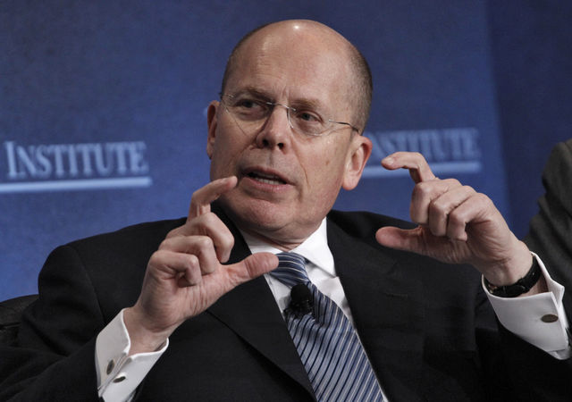
CEO Salaries
Total
2010 compensation:
$48.8
Million
Stephen Hemsley, CEO
United Health Group, Inc
StarTribune. April 13, 2011

Slide 45
Administrative Spending By Private Insurers
Do these “services” make patients healthier?
Do these “services” help me as a doctor diagnose, treat, or prevent illness?
Should we be spending these healthcare dollars on healthcare??

Slide 46
Growth of Physicians and Administrators
3000%
2500%
2000%
1500%
1000%
500%
0
Growth Since 1970
1970 | 1980 | 1990 | 2000 | 2010
Physicians
Administrators
Bureau of Labor Statistics; NCHS; Himmelstein/Woolhandler analysis of CPS
Notes:
“Difficult job to have excess capacity and technology and keep sick patients away from it.” – David Himmelstein
In 2000, BCBS of Massachussetts (non-profit) employed more workers to cover 2.5 million New Englanders than the nation of Canada employed to cover their country (population 27 million) – personal communication, Himmelstein

Slide 47
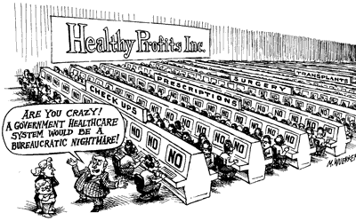

Slide 48
But Didn’t We Just Pass Historic National Reform?
Individual Mandate
Mandated health insurance for some (30 million will remain uninsured in 2016)
Policies required to cover at least 60% of costs
Raises costs
“While the legislation will enhance access to insurance, the trade-off will be an accelerated crisis of costs and perpetuation of the current dysfunction…”
– Jeffrey Flier
Dean of Harvard Medical School
Nardin et al, Health Affairs on-line, June 2013
Notes:
Absent the ACA, the CBO estimates 56 million would be uninsured in 2016.
New healthcare reform bill is akin to building a 3rd story on to a house w/ crumbling foundation.
Community health centers receive extra $1 billion
Only 20% of future uninsured will be undocumented Americans

Slide 49
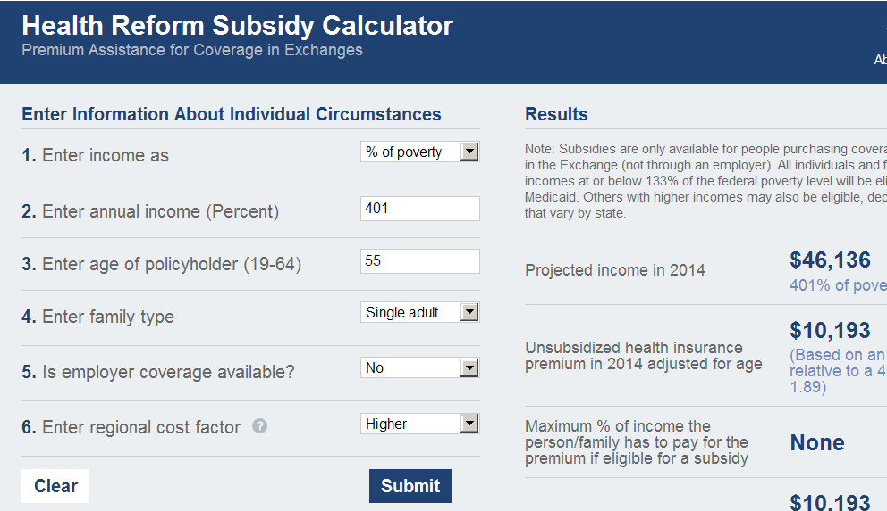
Under the ACA
Profile | 55 years old, single adult
Annual Income | $46,136
Premium | $10,193
Out-of-pocket max | Additional $6,250
Subsidies and tax credits | $0
Total exposure (dollars) | $16,443
Total exposure (% of income) | 36%

Slide 50
Under the ACA in Minnesota…
260,000 to remain uninsured
Exchange: on-line marketplace where ~ 20% of Minnesotans will obtain insurance coverage (includes the Medicaid population)
High deductible, catastrophic “bronze plan” will be offered:
$0 monthly premium
OOP limit for family of four at 138% poverty ($31,809) = $12,700
Notes:
$12,700 = 40% of $31,809

Slide 51
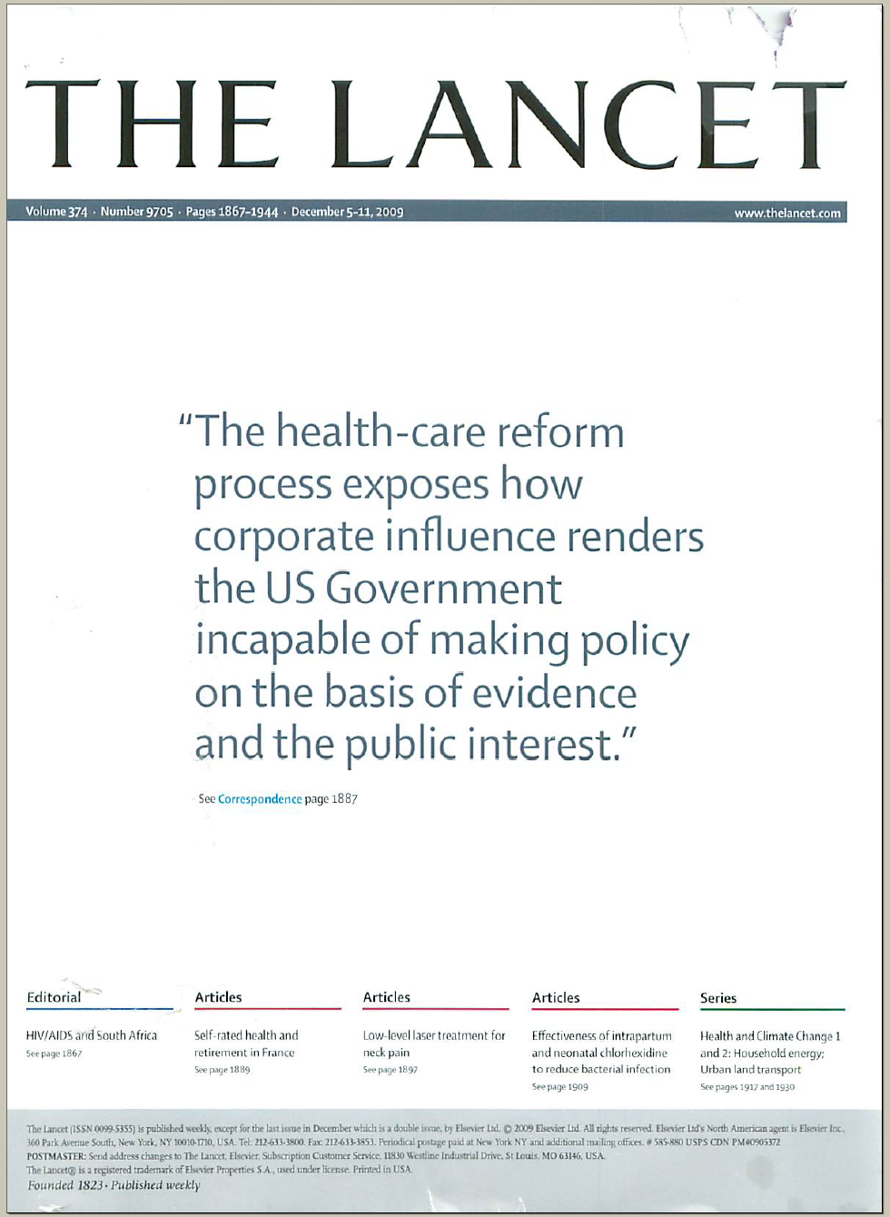

Slide 52
Is Single Payer Feasible???
We already have …
Excellent hospitals and well-trained professionals
The What
A nation of vast wealth with sufficient spending
The How
Acceptance of pooled resources to publicly fund the military, the NIH, the CDC, roads, schools, libraries, police and fire services, water sanitation, etc.
The Who

Slide 53
What Do Doctors Think of Single-Payer?
“In principle, do you support or oppose government legislation to establish national health insurance?”
Random sample of 5,000 US physicians, 51% response rate
Source: Carroll and Ackerman. Ann Int Med 2008;148:566

Slide 54
Senator John Marty, Chief Author SF18 / HF76
Notes:
Definition of “medically necessary care”: Health care that is appropriate to the enrollee’s diagnosis or condition, and diagnostic testing in terms of the type, frequency, level, setting, and duration of the intervention, and preventive services, and…consistent w/ generally accepted practice parameters as determined by healthcare providers in the same or similar general specialty as typically manages the condition, procedure or treatment at issue, and…helps resotre and maintain the enrolllee’s health or prevents deterioration of the enrollee’s condition. 1997 MN Statute 62Q.53
54

Slide 55
Lewin analysis of Single Payer in Minnesota
Average family would save $1,238 per year on healthcare expenses.
Average employer would save $1,214 per worker.

Slide 57
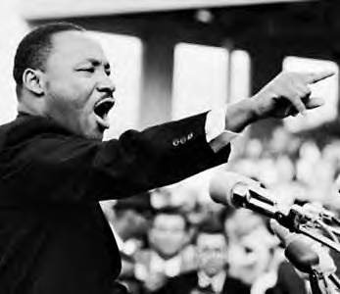
Thank You for Your Attention!
Educate yourself and others (www.pnhp.org)
Join HCAMn www.hcamn.org
Ask your legislator to coauthor the MHP
Invite a PNHP speaker
“Of all the forms of inequality,
injustice in healthcare is
the most shocking and inhumane.”
Dr. Martin Luther King, Jr.

